Slide 1
Task 11 - Forces and Vehicle Safety
By Jessica Tillman

Slide 2
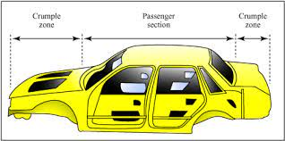
Principle A- Increasing the time of the collision or the time the occupants take to stop
Car engineers have developed ways to lessen the harm caused to car occupants by creating vehicles that crumple under impact. Crumple zones are a safety feature built into cars. Crumple zones are areas of automobiles that are intended to collapse in the event of a collision. In two different methods, crumple zones reduce the impact of an auto collision. Crumpling reduces the likelihood that the car would rebound after collision, reducing the change in momentum and the impulse. The car's crumpling also extends the period of time during which its momentum is altered, which significantly lessens the force of the crash by extending the collision's duration.
Crumple Zone Diagram

Slide 3
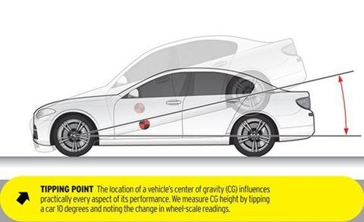
Principle B- Spreading the forces of impact over the largest possible area & ensuring stability of the vehicle.
Crumple zones also apply to the physics principle that it spreads the impact of the force. By doing so, some of the energy is absorbed, and the impact is prevented from being passed onto the occupants of the vehicle.
The stability of a car is dependent on its center of gravity. The center of gravity and theoretical central focus of the car, sometimes referred to as the center of mass, is where all of its parts, weight, and forces will act most strongly. In other words, it is where the entire mass of the vehicle is located. Modern cars are built closer to the ground to have a lower center of gravity and to improve stability as well as the handling of the car.

Slide 4
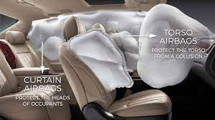
Principle C- Minimizing contact of the person with the interior of the vehicle
Airbags are a safety feature in cars which help prevent contact with the vehicle. The airbag is designed to expand as soon as the car begins to slow down after an accident, and then deflate as your head comes into contact with it. This is crucial because if the airbag didn't collapse, your head would just rebound off of it, leaving you in no better shape. It would defeat the whole purpose of airbags.
Another safety feature that applies to this principle are seatbelts. In newer cars, seatbelts are made to work together with the airbags. The seatbelt decreases the speed of the occupants during a collision, allowing them to safely collide into the airbag. Without a seatbelt, a passenger in a collision will continue to move forwards at the same speed as the car until anything stops them.

Slide 5
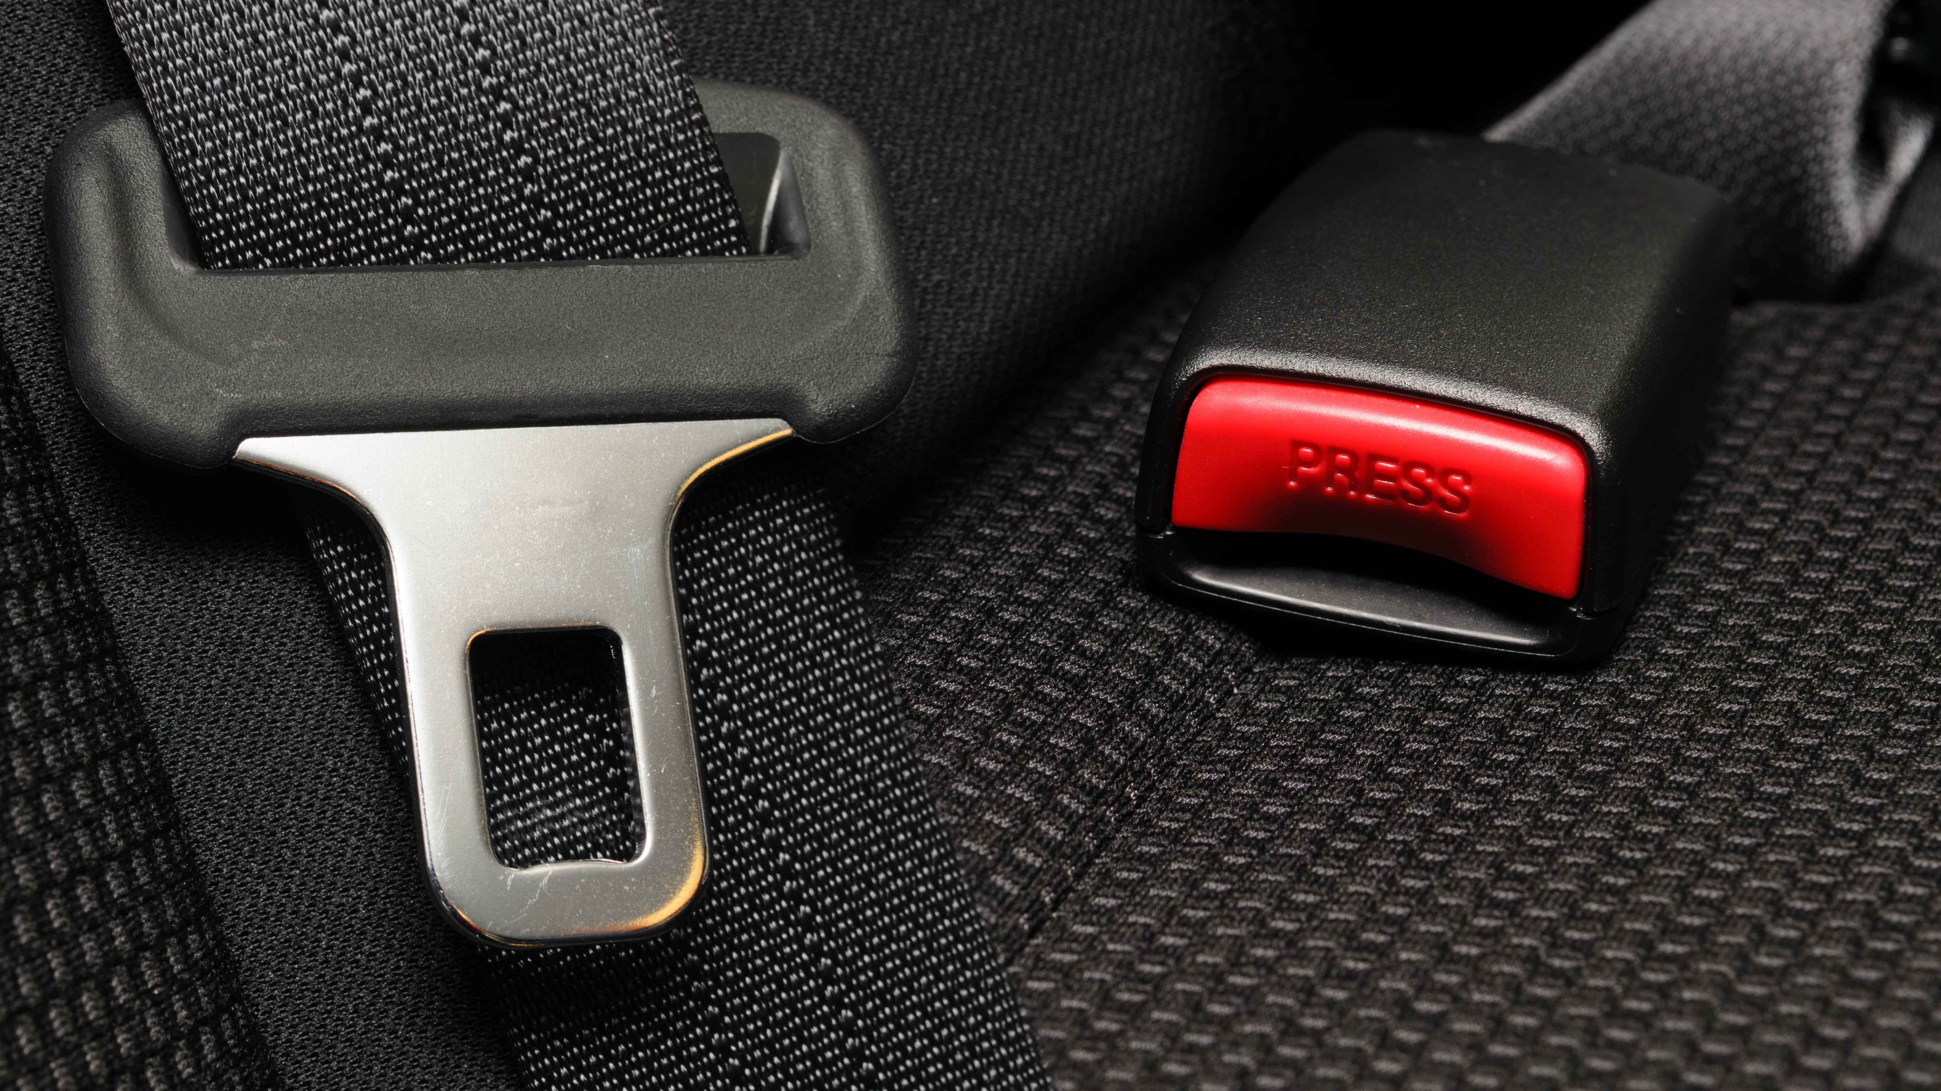
Principle D- Keeping the person inside the vehicle
Seatbelts also apply to the law of inertia and keep the occupant inside of the vehicle. A seatbelt is designed to to lessen the chance of being launched from the vehicle by causing the occupant to decelerate at the same speed as the vehicle in the event of a collision. Seatbelts stop the transfer of energy.
It is important to make sure the seatbelts are always tightened effectively. A seatbelt that isn't properly adjusted will let the driver or passenger move forwards in a collision, which raises the possibility that their heads will make contact with the dashboard.

Slide 6
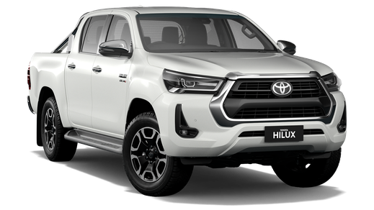
Safety Features of a 2021 Toyota Hilux
Trailer Sway Control- A standard feature on HiLux vehicles is Downhill Assist Control, a smart safety feature that corrects and helps reduce sway. The impact absorbing body is designed and built to reduce impact in a collision and the high tensile steel provides greater upper and underbody strength. When engaged, drive start control can automatically help suppress the impact of sudden acceleration.
Road Sign Assist- Front-mounted smart cameras that recognise specific Australian speed signs will notify you when it's time to modify your speed.
Pre-Collision Safety system- The Pre-Accident Safety (PCS) system in the HiLux uses the vehicle's in-built camera and radar to warn you when a frontal collision with another car, a pedestrian, or a daytime cyclist is likely and, if necessary, will assist you in applying the proper amount of brake pressure.
Lane Departure Alert- If the HiLux detects you have strayed from your lane while moving at a speed more than 50 km/h, it will buzz and show a visual warning on the Multi-Information Display.
High Speed Active Cruise Control- HiLux maintains you at a pre-selected speed while automatically accelerating and decelerating in accordance with the traffic in front of you using its integrated camera and radar located on the front grille.
Airbags- There are seven SRS airbags fitted as standard that help provide a protective barrier around the interior space.
Seatbelts- There are five seatbelts.

Slide 7
Hilux Safety Features Linked to Physis Principles
Principle A and B- High Speed Active Cruise Control and Road Sign Assist because they help regulate/ control speed, which can increase the time taken to stop. Pre-Collision Safety system because it helps warn of a collision and to increase the braking distance. It also creates more stability of the car and it absorbs some of the energy that would otherwise be transferred to the occupants.
Principle C- Airbags-There are seven airbags to help provide a protective barrier around the interior space and prevent contact with the inside of the vehicle.
Principle D- Seatbelts- There are five seatbelts in the vehicle to keep the occupants restrained and secure.

Slide 8
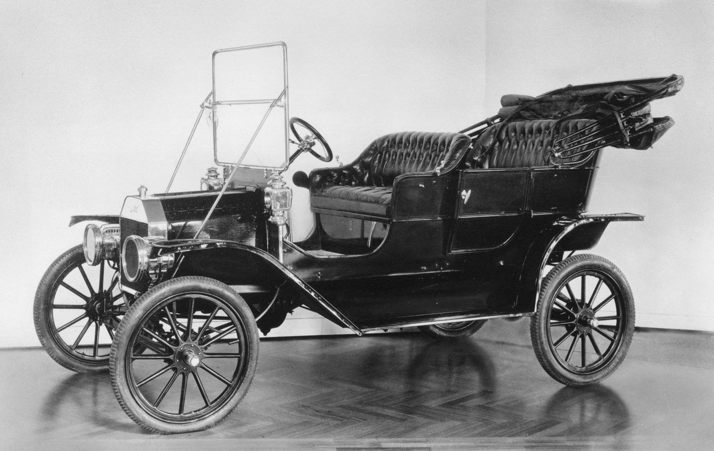
Ford Model T
Many aspects of the auto business were transformed with the Ford Model T, which was also the first car that most Americans could afford. However, the vehicle didn’t contain many or any safety features.
There were no crumple zones. Seatbelts and airbags were omitted, which meant the occupants of the vehicle were more likely to be injured in a collision. There was nothing that kept them in place or prevented contact with the car. Since the cars' gas tanks were under the seats, they posed a fire risk, and anyone thrown from the vehicle in an accident would suffer serious injuries from the flat glass windshields.

Slide 9
Link of Physics Principles to Ford Model T
Cars prior to the 1960’s, such as the Ford Model T, didn’t have crumple zones implemented. Without crumple zones, the deceleration time wouldn’t be reduced, and the car wouldn’t stop gently. It would be more sudden and the force the driver and passengers feel during a collision would be increased. Seatbelts weren’t legally required until the late 1960’s-1970’s, so not many vehicles had them prior. This means that the occupants of the car would be more likely to go through the windscreen in the event of a crash. There would be nothing keeping them restrained. This applies to Newton’s first law- that an object will remain in motion or in rest, at a constant speed and in a straight line, unless acted upon by an unbalanced force. Airbags were only first introduced in the 1970’s. Since these safety features were omitted in the Ford Model T, the occupants of the vehicle would hit the inside of the car and injure themselves during a collision.

Slide 10
The Role of Safety Design in a Vehicle
The best chances of surviving an accident are given by a solid structure, good restraint systems, and active safety support technologies in a car.
Crumple zones, seat belts, and airbags all offer protection in the event of a collision, but active safety aid technologies that can stop a collision from happening are now a key point of differentiation.
It is important to have modern safety features implemented in cars to give people the best possible chance of surviving and avoiding injury.

Slide 11

Suggestions For Improvements
I think cars could be safer if they had a better seatbelt design and had airbags in more places. The airbags help to stop impact with the inside of the vehicle and the seatbelts keep the people from flying through the windscreen. By implementing better, updated features, the occupants won’t be impacted by the forces as much.

Slide 12
References
https://rac.com.au/car-motoring/info/future_history-of-car-safety
https://www.nsw.gov.au/driving-boating-and-transport/roads-safety-and-rules/vehicle-safety-and-compliance/safety-features
https://roadsafety.transport.nsw.gov.au/stayingsafe/vehiclesafety/seatbeltsrestraints/index.html
https://www.toyota.com.au/hilux#safety
https://www.usatoday.com/picture-gallery/money/cars/2019/07/22/ford-chevy-toyota-deadliest-cars-in-history/39682167/
https://www.greeleytribune.com/2016/01/08/4-safety-features-cars-100-years-ago-didnt-have-sponsored/

